Slide 1
Customer Churn Prediction
Telecommunication Industry
Machine Learning Project Presentation

Slide 2
Group Details
Group number: 5
Team members:
Mohamed Kumail Abbas
H.Mohith
Shaima Samad
Janhawi Sharma
Abhishek Patil
Praveen Singh Thakur
Project Co-ordinator: Mr Dilawar

Slide 3
Business Objective
The objective is to build a predictive model that estimates churn probability based on customer features.
This project focuses on a binary classification problem to predict whether a customer will churn or remain loyal.

Slide 4
Dataset Details
Parameter | Details
Dataset Name | telecommunications_churn.csv
Total Records | 3333 Customers
Total Features | 19 Variables
Problem Type | Binary Classification
Target Variable | Churn (1 = Churn, 0 = No Churn)
Account Features | account_length
Plan Features | voice_mail_plan, international_plan
Usage Features | day_mins, evening_mins, night_mins, international_mins
Call Count Features | day_calls, evening_calls, night_calls, international_calls
Charge Features | day_charge, evening_charge, night_charge, international_charge, total_charge
Service Interaction | customer_service_calls
Additional Feature | voice_mail_messages

Slide 5
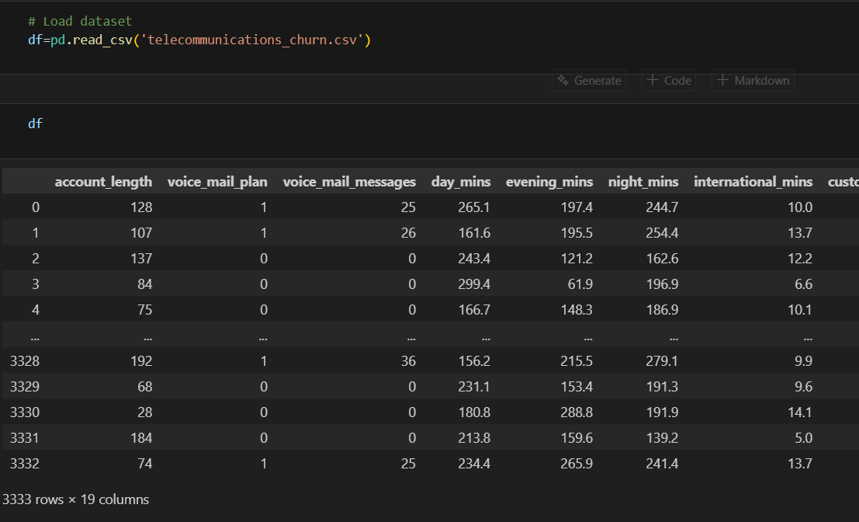

Slide 6
Exploratory Data Analysis (EDA)
Checked data structure using head(), info(), describe().
Analyzed churn distribution.
Correlation heatmap generated.
Observed higher churn in customers with:
- More customer service calls
- International plan users

Slide 7
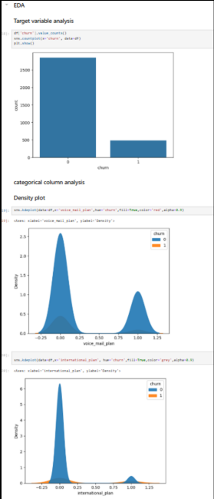
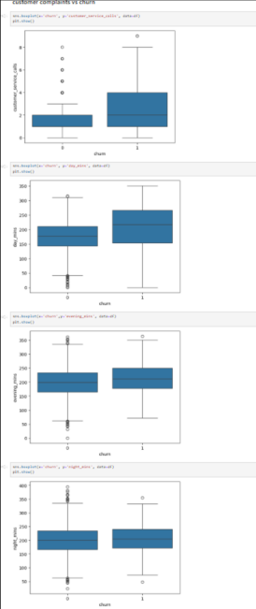
Insights of EDA

Slide 8
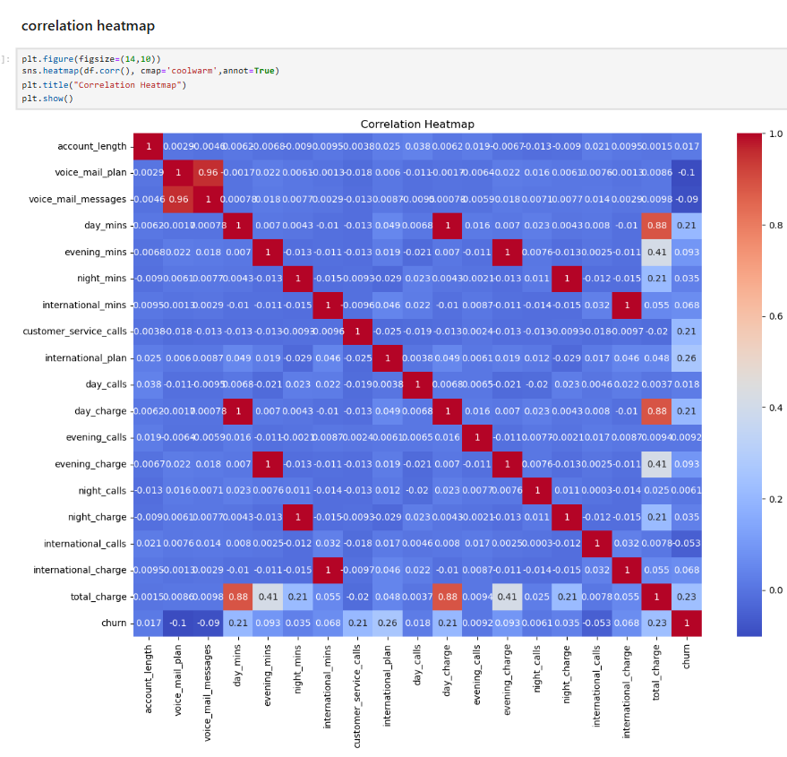

Slide 9
Data Preprocessing
Encoded categorical variables (Label Encoding).
Verified no missing values.
Feature-target split performed.
Train-Test split (80% training, 20% testing).

Slide 10
Model Building
Logistic Regression
Decision Tree
Random Forest
K-Nearest Neighbors
SVC (support vector mechanism)
Boosting
(Compared multiple models for best performance)

Slide 11
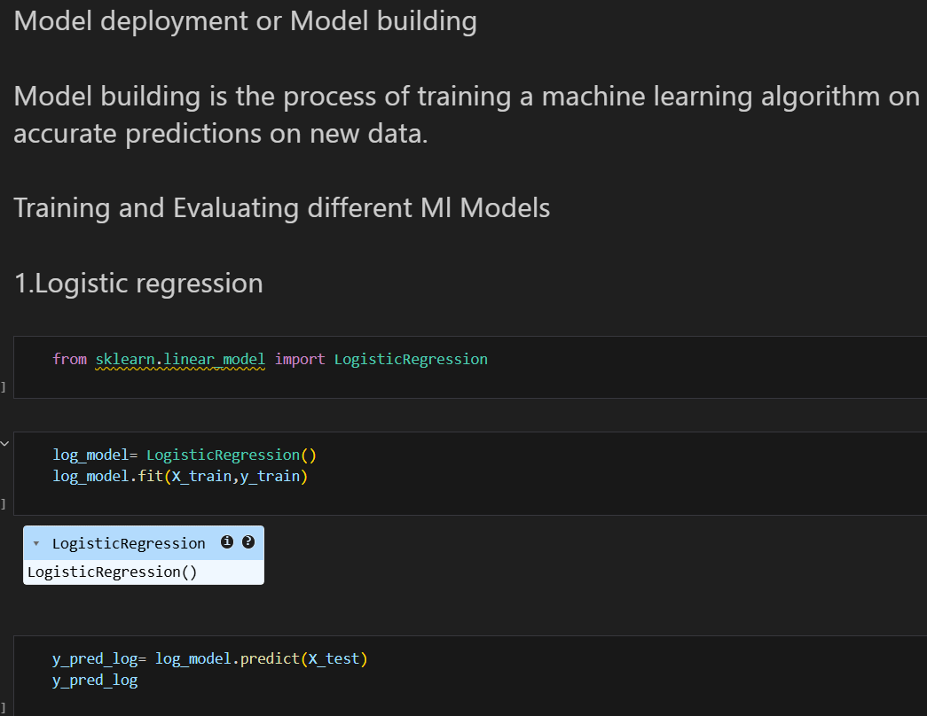

Slide 12
Model Evaluation
Evaluation Metrics Used:
- Accuracy
- Precision
- Recall
- F1-Score
Confusion Matrix generated.
(Best performing model selected)

Slide 13
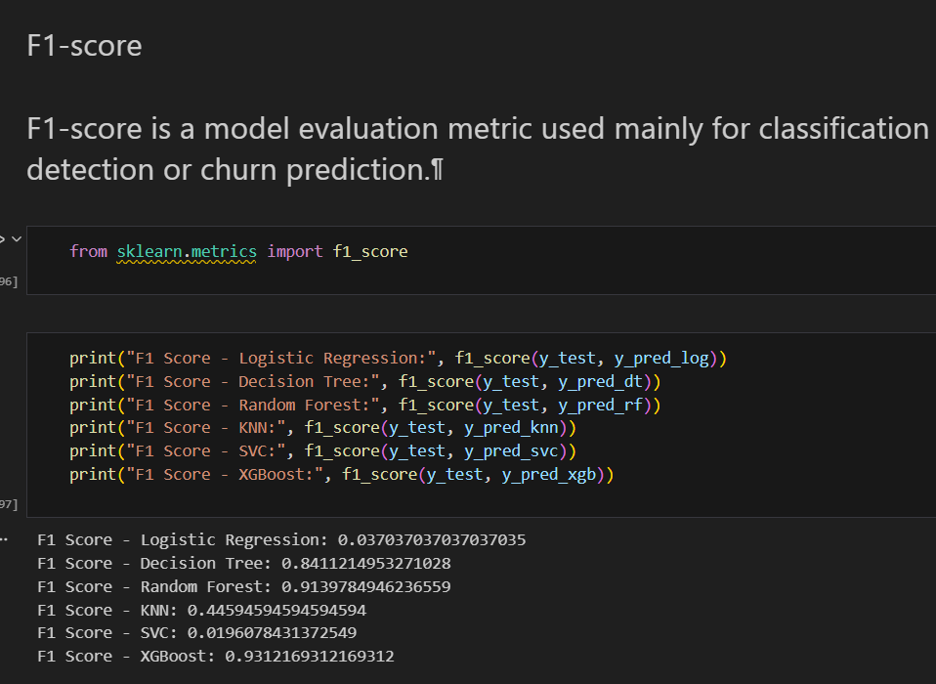

Slide 14
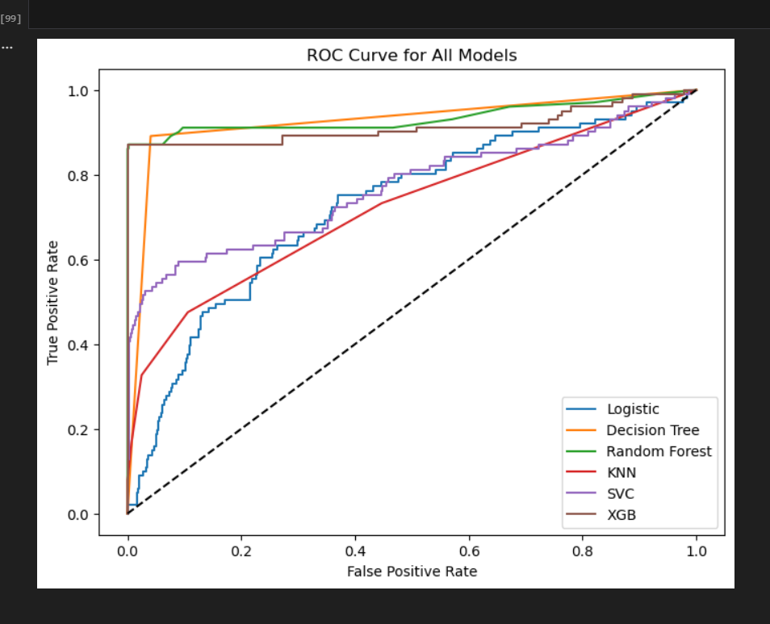

Slide 15
Problems Encountered
Class imbalance in churn variable.
Encoding categorical variables properly.
Overfitting in Decision Tree model.
Feature correlation handling.
Model predicting fewer classes issue.

Slide 16
Final Results
Best Model: XGboost.
Achieved high prediction accuracy.
Successfully identified potential churn customers.
Model ready for deployment.

Slide 17
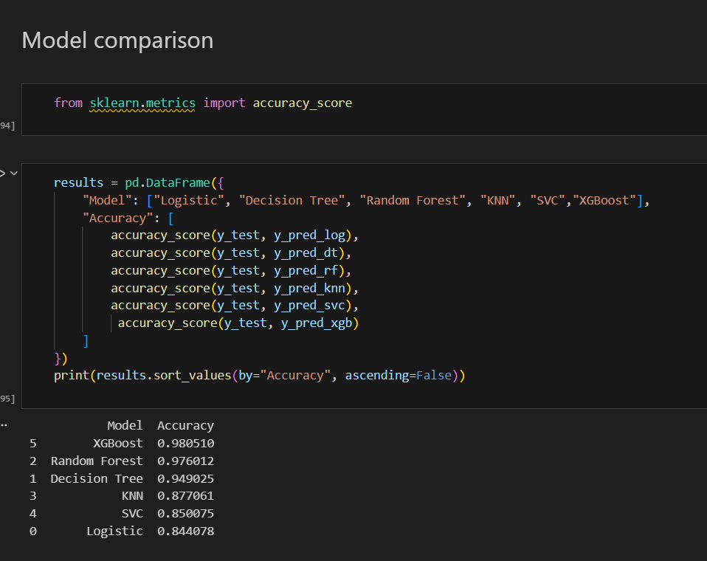

Slide 18
Deployment Plan
Model saved using Pickle.
Deployment using Flask or Streamlit.
User inputs customer data.
Model predicts churn probability in real-time.

Slide 19
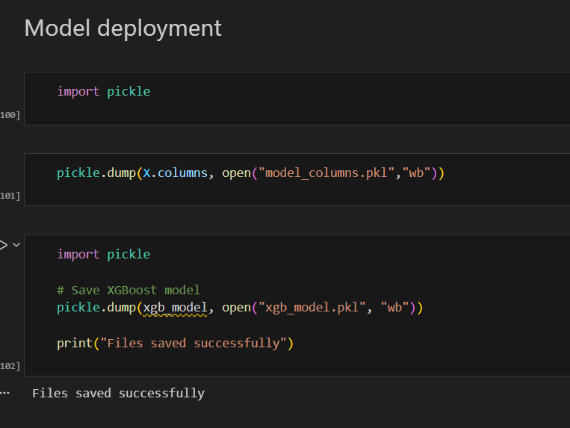

Slide 20
Business Impact
Reduce customer loss.
Improve retention strategies.
Better marketing targeting.
Increased revenue stability.
Data-driven decision making.

Slide 21
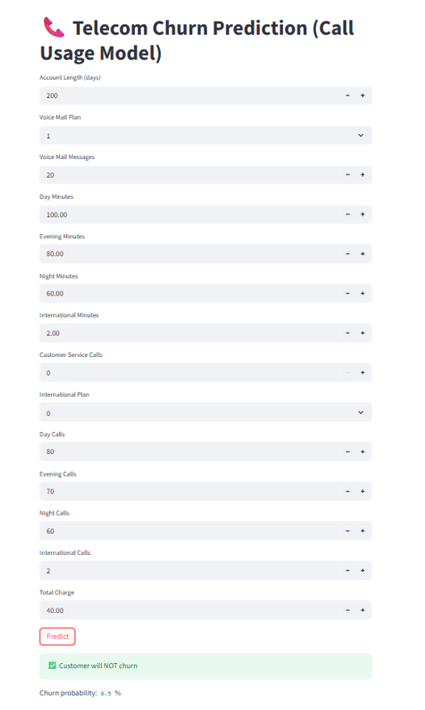

Slide 22
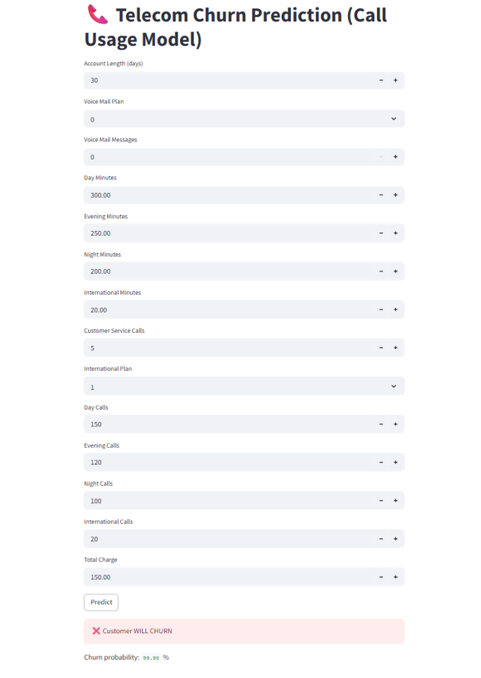

Slide 23
Conclusion
Successfully built churn prediction model.
Compared multiple ML algorithms.
Selected best model based on performance.
Deployment-ready solution delivered.

